Slide 1

Cryptocurrency ATM Transaction Forecasting
Automated cash-demand prediction pipeline using Python, AWS S3 + Redshift & Power BI

Slide 2
Objective
Forecast daily ATM withdrawals to optimize cash replenishment and reduce idle funds.
Business Motivations:
Eliminate ATM cashouts and unnecessary cash loading
Enable real-time visibility into daily cash needs
Replace manual 3-hour reporting with automated 20-min refresh

Slide 3
Tech Stack
• Python (ETL + ML)
• AWS S3 - data lake
• AWS Redshift Serverless - warehouse
• Power BI - dashboard

Slide 4
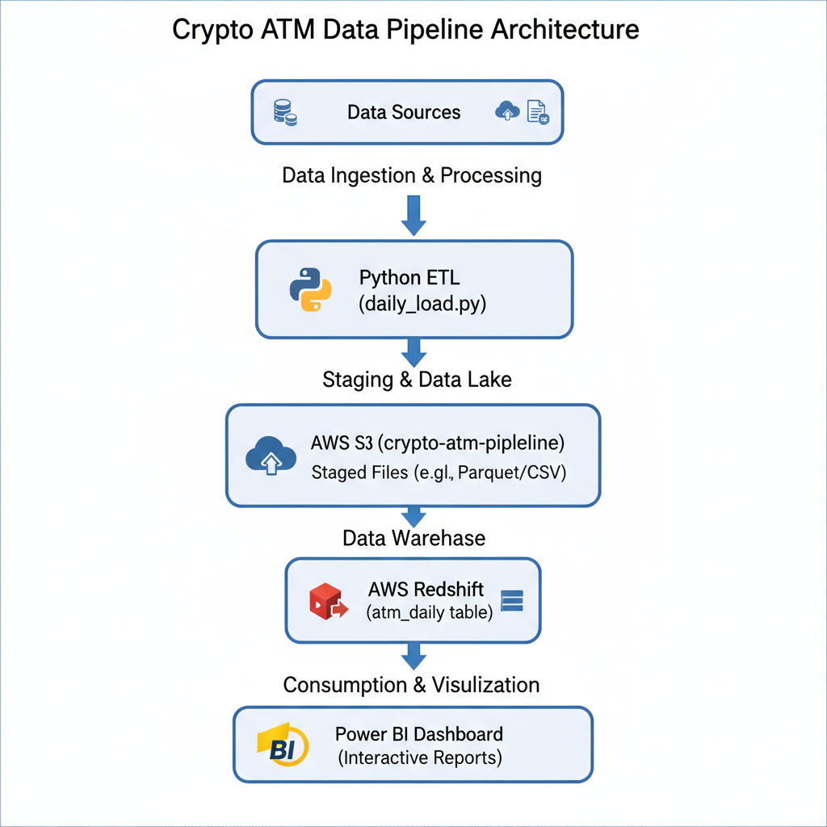

Slide 5
Model Performance
Model | RMSE | MAPE | Key Drivers
Random Forest | 3,414 | 6.49 % | wd_lag_1, txn counts
XGBoost | 3,733 | 7.01 % | btc volatility, btc close

Slide 6
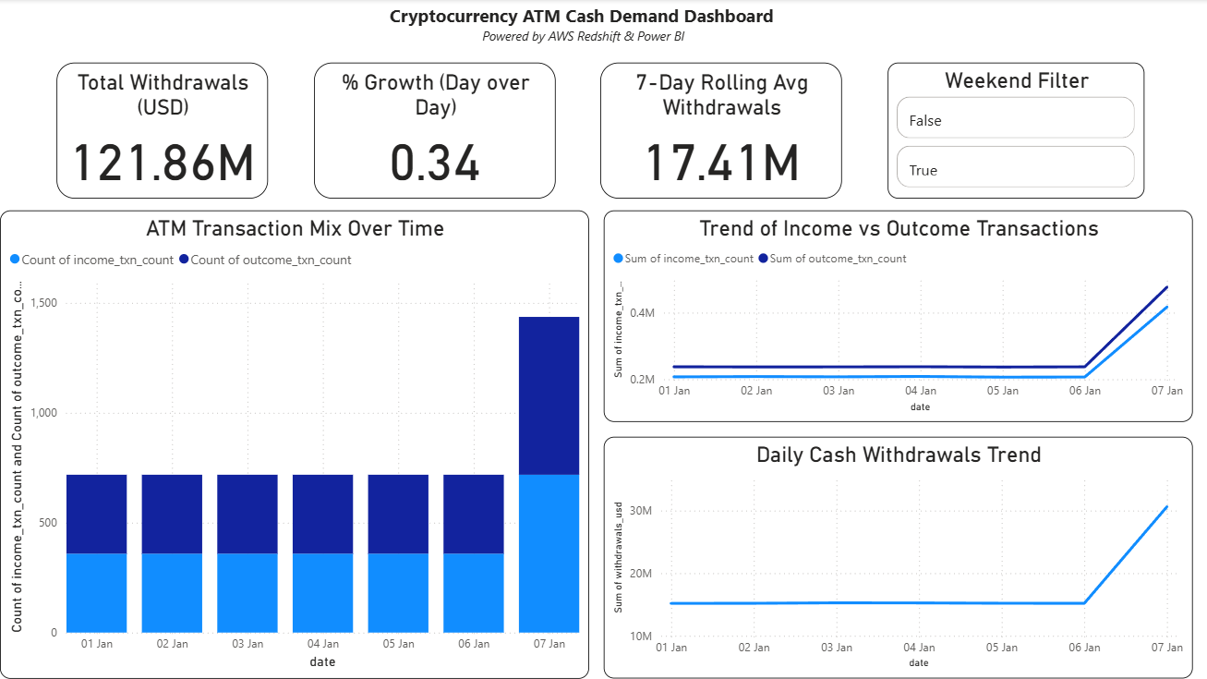

Slide 7
Business Impact
Results
• ETL Automation: 3 hrs → 20 min
• Daily pipeline simulated via Task Scheduler
• Power BI refresh → instant trend updates
Business Impact
• Reduced idle cash by ≈ 20 %
• Improved replenishment planning efficiency
• Executive dashboard for real-time decisions

